Slide 1


Using Python to automate data visualization to capture business trends

Slide 2


What is Python
Python is an interpreted high-level programming language that emphasises code readability
It is dynamically typed and garbage collected meaning it automatically de-allocates memory from the heap
It supports Object Oriented and functional programming
The sample Hello World function

Slide 3


Why Pandas?
Pandas is a built-in software library used for data manipulation and analytics. It offers data structures and operations for such tasks
Pandas allows Python developers to import data from SQL, JSON, Excel and .CSV documents
Matplotlib is an extension that provides an object-oriented API into embedding plots like
Line charts and pie graphs

Slide 4
The Problem
I want to capture the latest investment trends through automation. In my previous assessment I manually created pivot tables based on the requirements as well as line graphs and heatmaps that followed.
Now I know that I could use Python to automate the data, it is time to repeat the assessment using what I have learned.

Slide 5
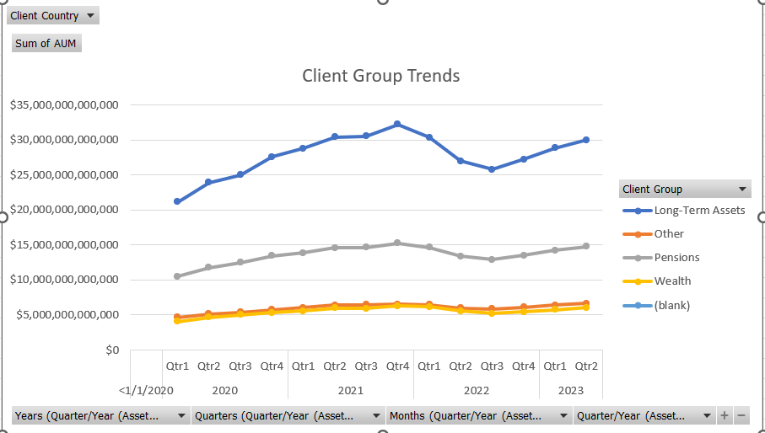
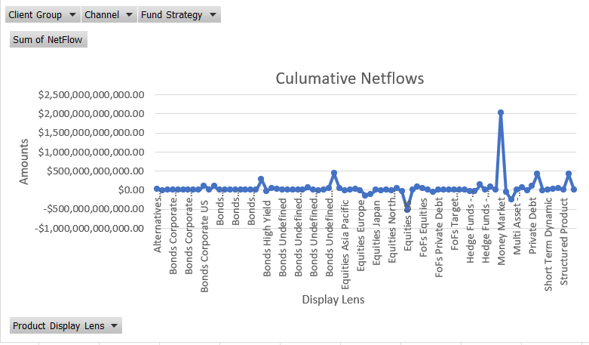
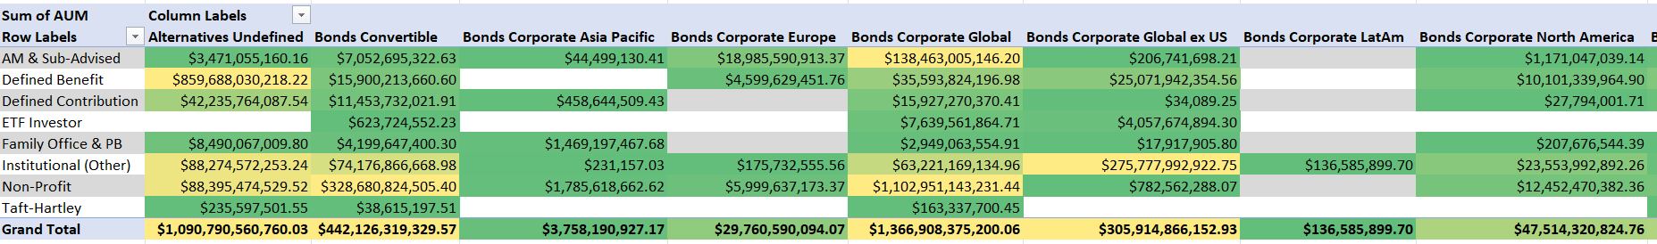

Slide 6

Setting up a Google Colab
Before I setup a google colab, I created a folder on my local drive entitled “Schroders” to host file relevant to this project
It is necessary to do so to allow the notebook to connect to the files
Then to test if the notebook works, I ran a “Hello World”

Slide 7
Functions
For organization and cleanliness purposes, I created a .py file entitled “Schroder’s Methods” that hosts all function definitions so that when imported into the notebook, I could call the functions right away
For most of these functions, a placeholder the dataset serves as a parameter for input

Slide 8
The Methods I used
AUM_to_Numeric(dataset)
NetFlows_to_numeric(dataset)
asset_class_pivot(dataset, country)
line_graph_asset_class(pivot_table)
net_flow_pivot(dataset)
line_graph_net_flow(pivot_table)
heatmap_pivot(dataset, strategy)
create_heatmap(heatmap_pivot)

Slide 9
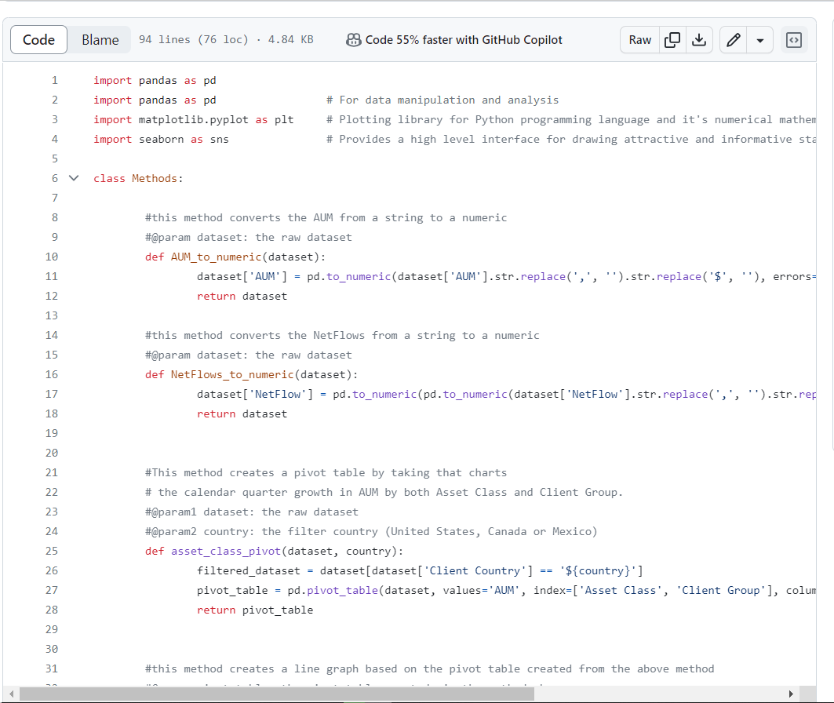

Slide 10
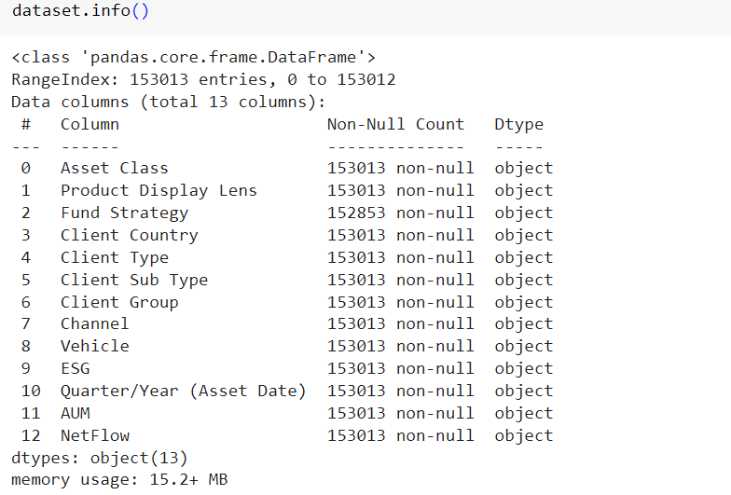
Prepping & Profiling the Data
Connect to the google drive folder “schroders” in order to mount both the dataset and the methods class file
Print the head of the dataset to test your connection
Use the built-in shape, columns, info ( ), and describe ( ) methods to better understand your dataset

Slide 11
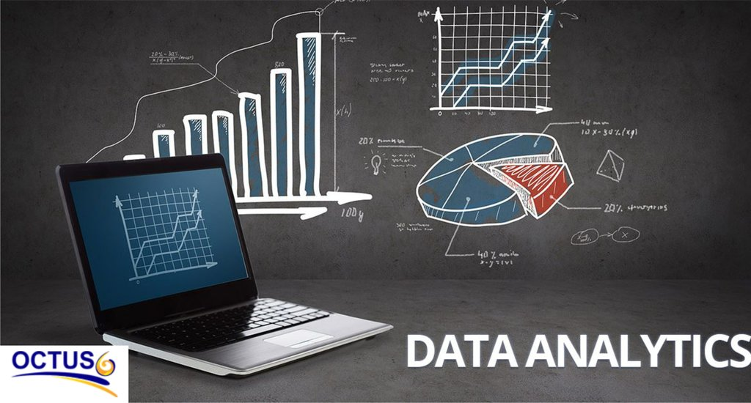
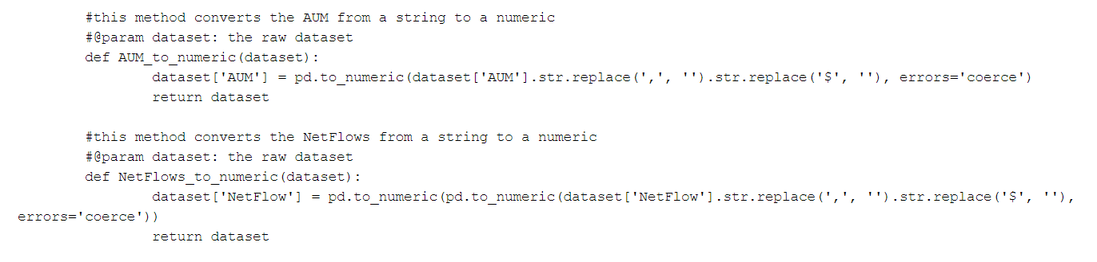
Processing the Data
As seen above the AUM and NetFlow have defaulted to object data types
In order to create the required charts and graphs we need to convert them to numeric data types
Luckily we have methods from the Methods class that could do it for us

Slide 12
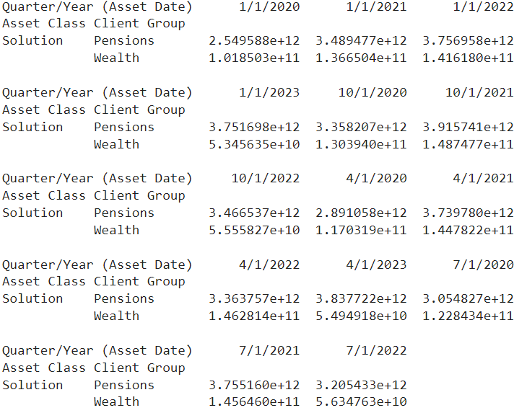
Capturing the quarterly growth in AUM by both Asset Class and Client Group.
Create a pivot table using the requirements above (the calendar quarter growth in AUM by both Asset Class and Client Group) with countries as a filter. To automate I called the function with Canada as an example filter parameter. It would work the same with The United States or Mexico

Slide 13
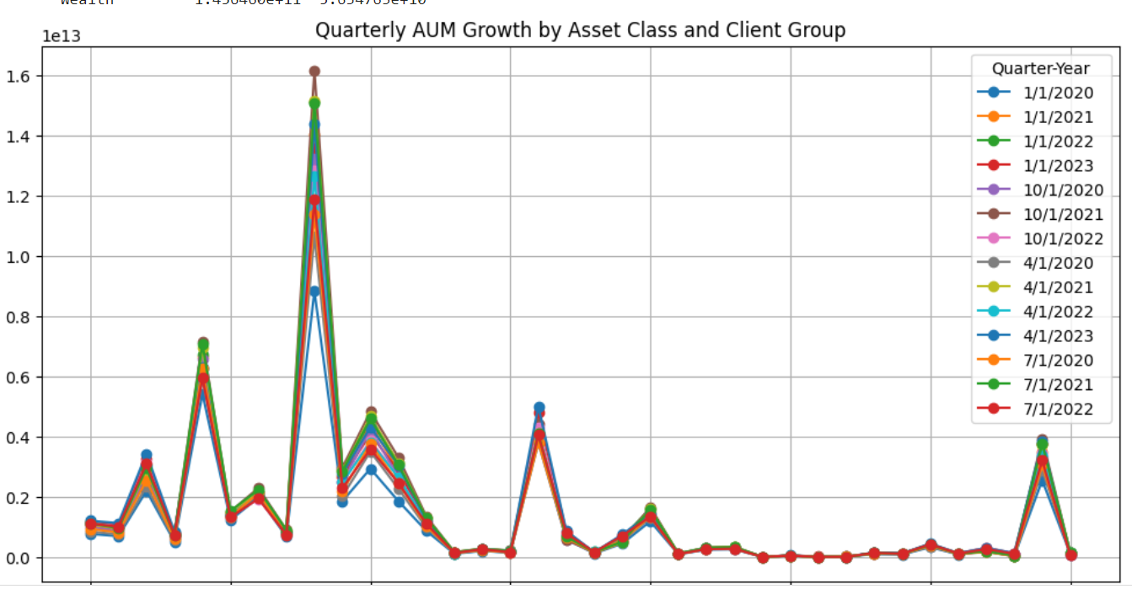
Asset Class/Client Group Chart

Slide 14
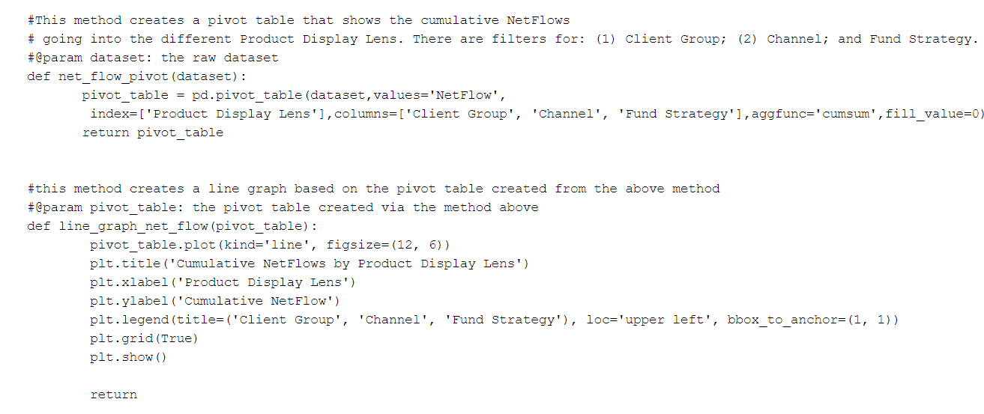
methods for Pivot Table & Line Graph

Slide 15
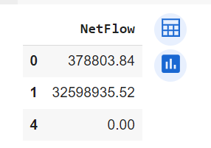
Capturing the cumulative NetFlows going into the different Product Display Lens
Same procedure as above but I made a pivot table for the cumulative netflows and the filters described in the requirements. The index is the ‘Project Display Lens’ field while the columns are the 'Client Group', 'Channel', 'Fund Strategy’ fields from the raw data

Slide 16
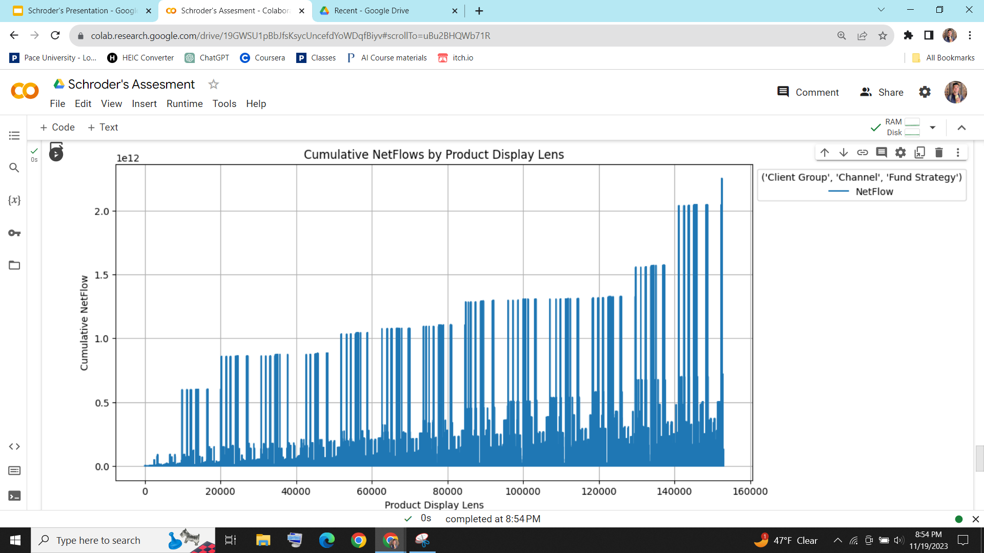
NetFlows Chart

Slide 17
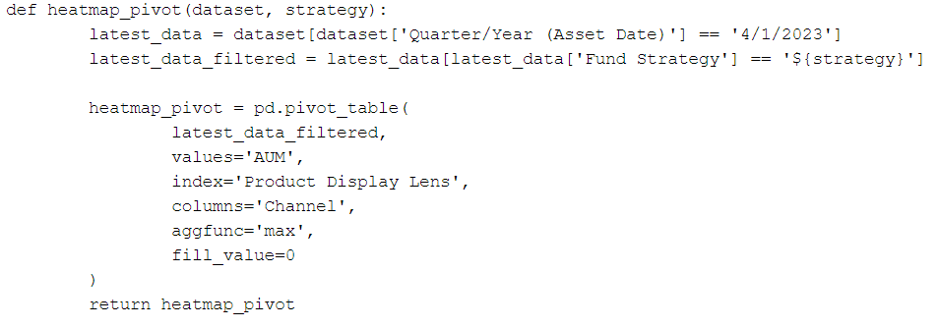
Finding the channel with the largest latest AUM
Before we make a heatmap that would find the channel with the largest latest AUM as of Q3 2023 by Product Display Lens, it is necessary to create yet another pivot table with the following methodology

Slide 18
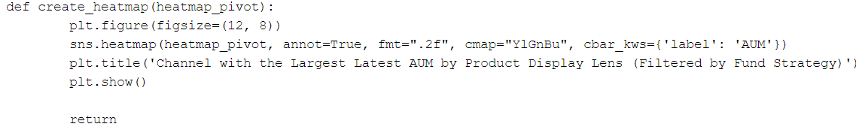
Finding the channel with the largest latest AUM (cont..)
From there we can now use the following methodology to create the heatmap
Unfortunately, my methodology returned an empty dataset even with an active filter parameter, therefore I was unable to complete this task

Slide 19
Thank You

Slide 20
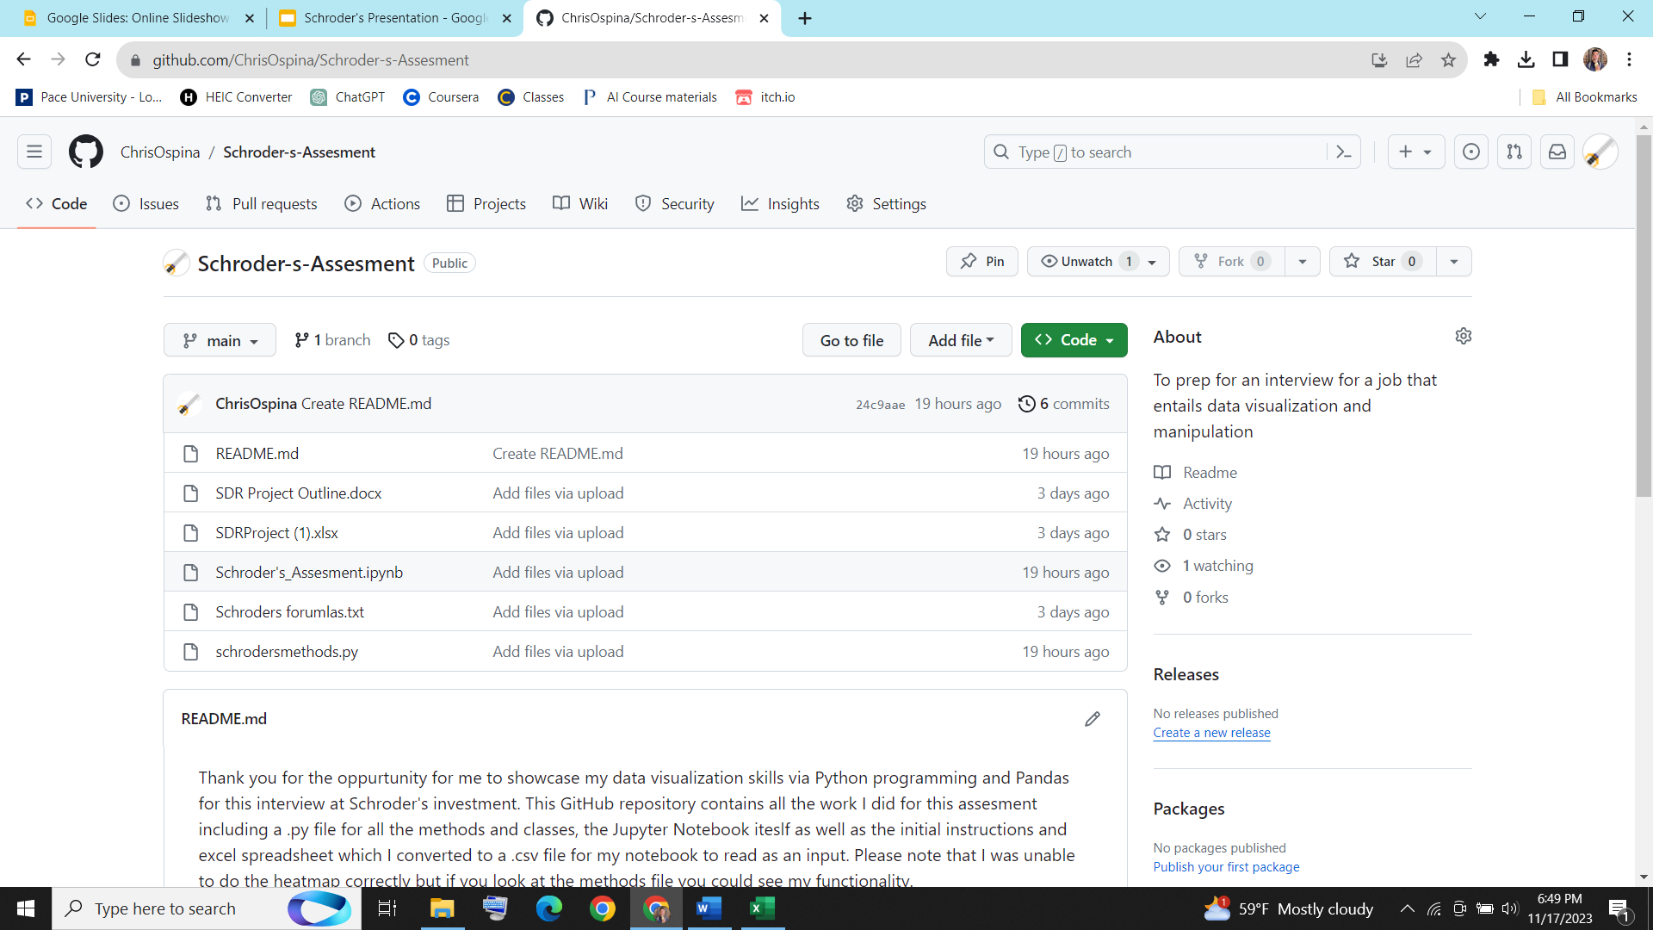
GitHub

